Slide 1
Elixir – Deep Photo
郑博文 11611611
郑浩 11610127
吕俊延 11610226
黄义劲 11610128
陈士杰 11612028
何海滨 11611601

Slide 2
Outline
Introduction & Scenarios
Timeline
Features
Testing
Conclusions & Future Work

Slide 3
Outline
Introduction & Scenarios
Timeline
Features
Testing
Conclusions & Future Work

Slide 4
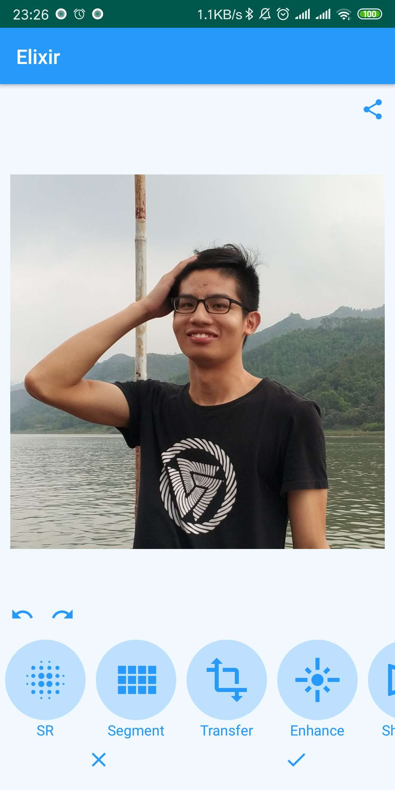
Introduction
DeepPhoto offers features such as taking photos, adding filters, editing images and uploading them to social networks. Our app features a well designed user interface. A great image can be generated with only just a few touch and taps. We also provide an expert mode for professional users.

Slide 5

Scenarios
Background Segmentation
Soften the background to highlight you.
Super Resolution
Have a better view on low-res photos.
Style Transfer
Share your photos with interesting styles.
Photo Enhancement
Make your photo colorful.

Slide 6
Outline
Introduction & Scenarios
Timeline
Features
Testing
Conclusions & Future Work

Slide 7
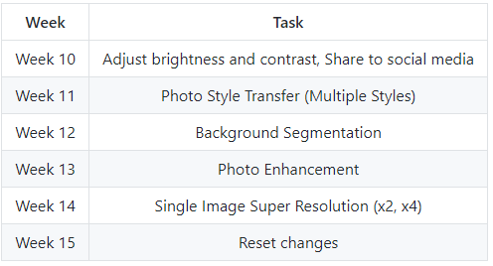
Timeline & Version Iteration

Slide 8
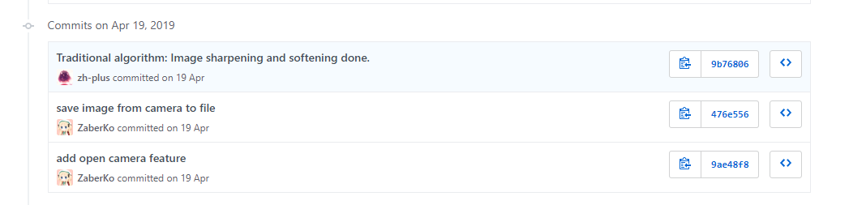

Timeline & Version Iteration

Slide 9
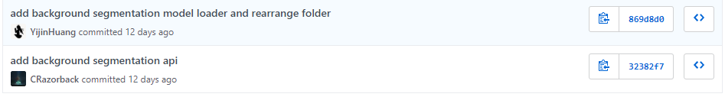
Timeline & Version Iteration

Slide 10
Outline
Introduction & Scenarios
Timeline
Features
Testing
Conclusions & Future Work

Slide 11
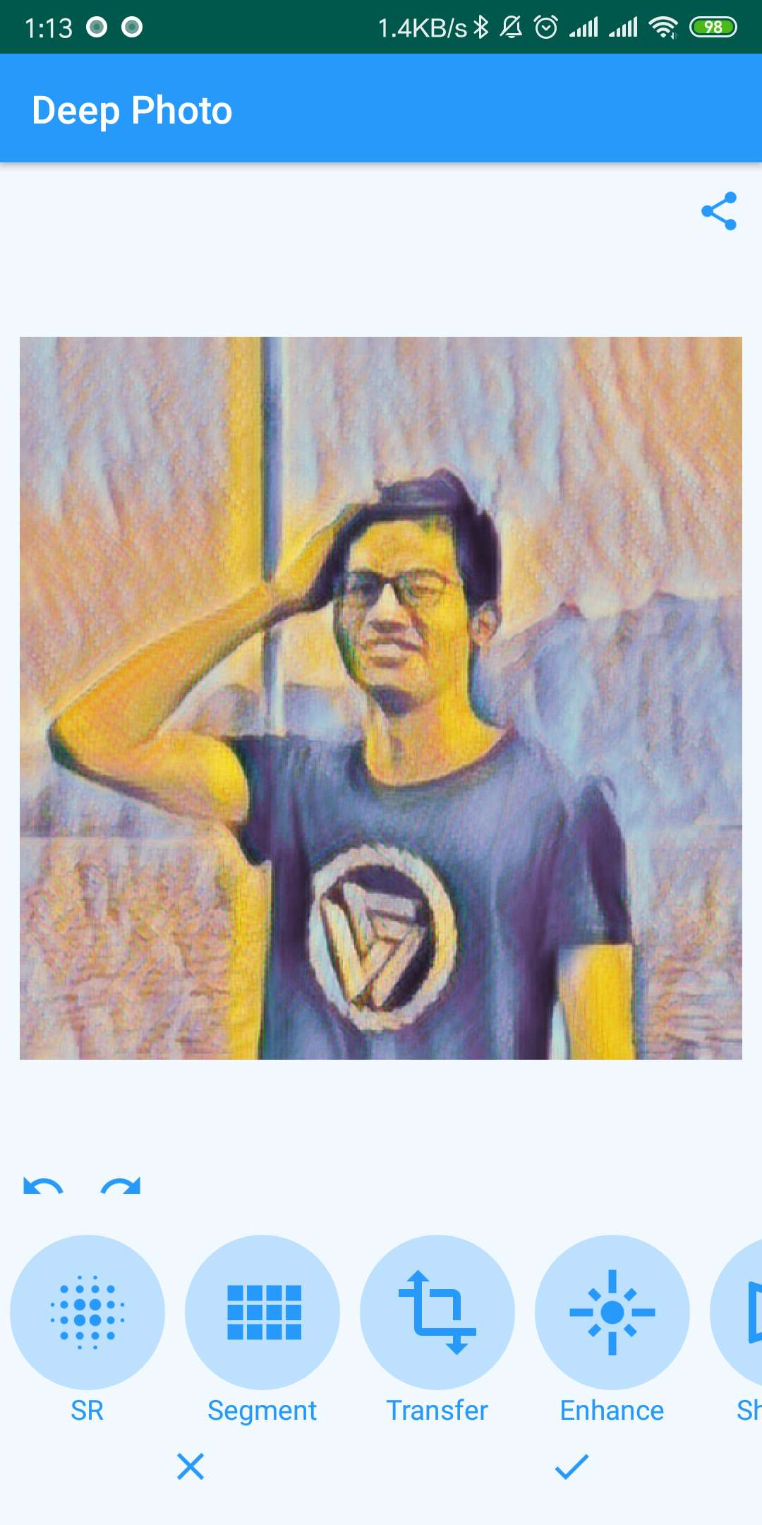
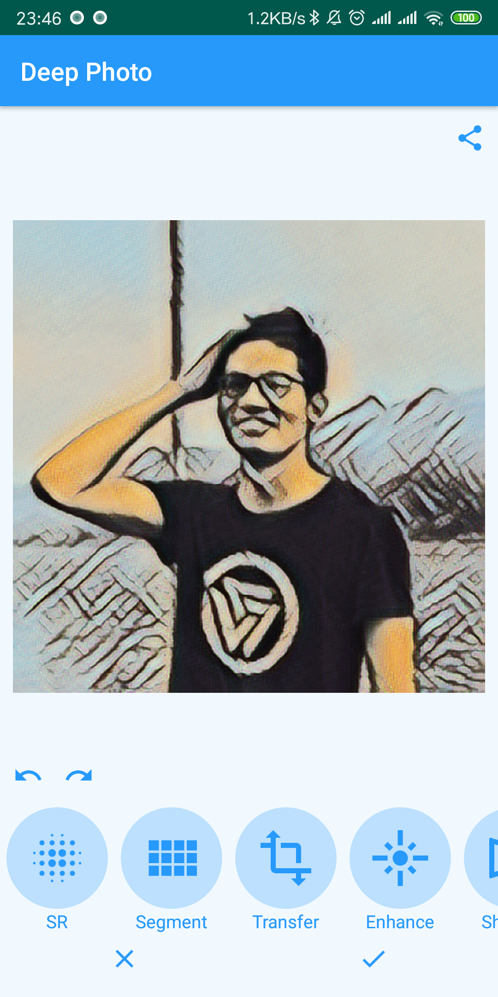

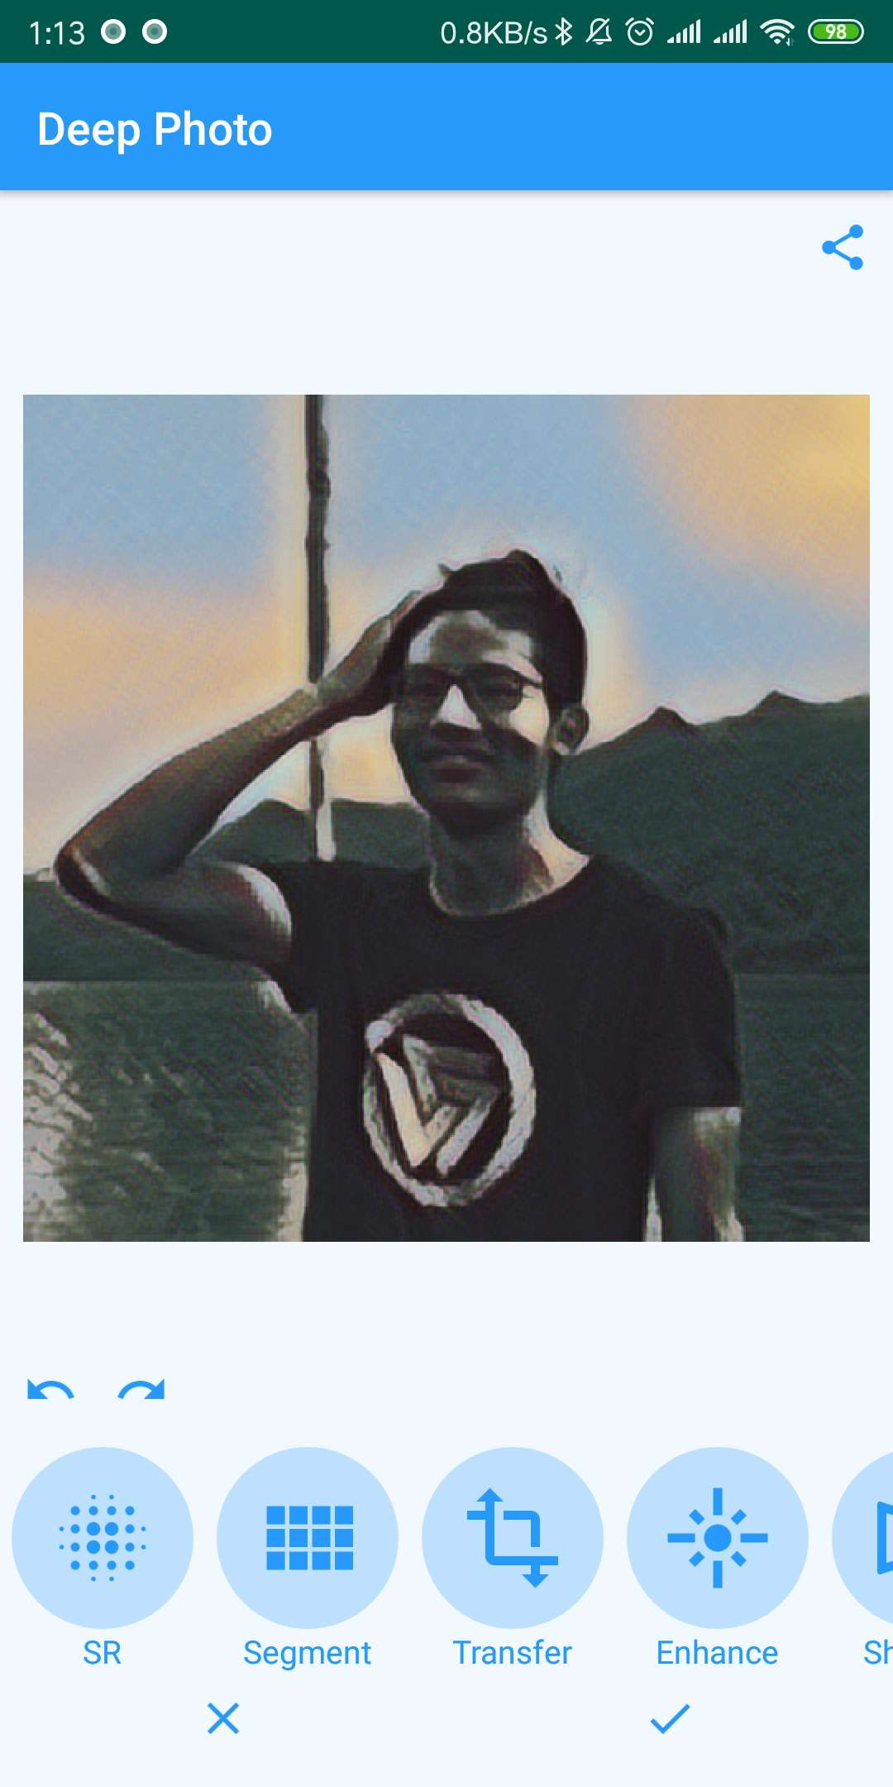
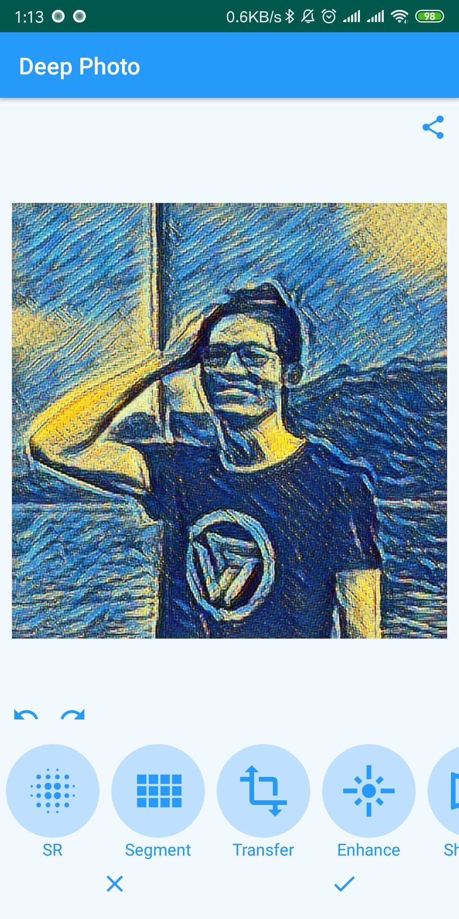
Photo Style Transfer

Slide 12
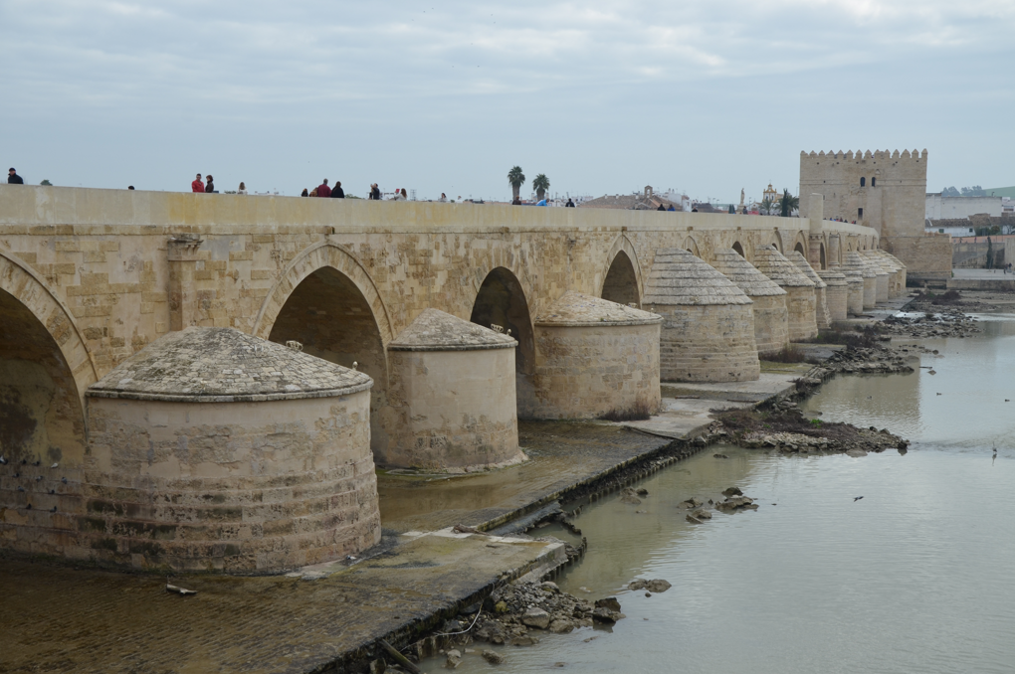

Super Resolution

Slide 13
Super Resolution

Slide 14

Background Segmentation

Slide 15
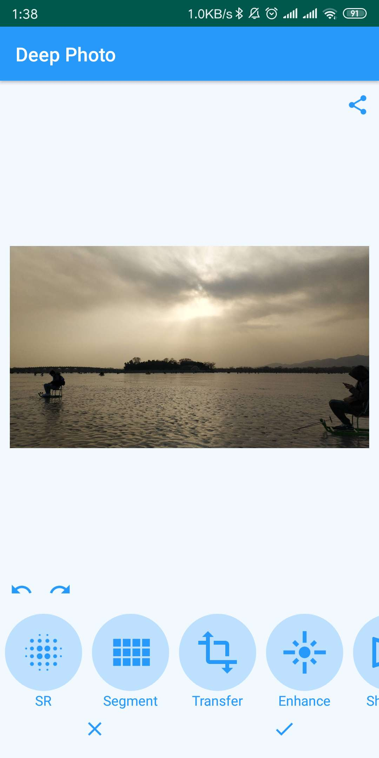
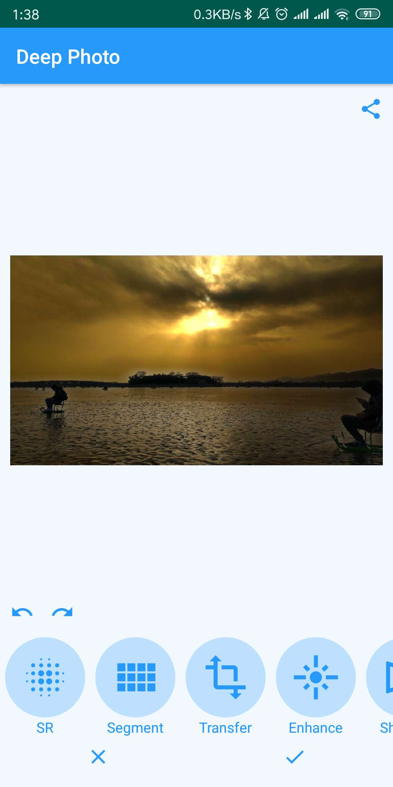
Photo Enhancement

Slide 16
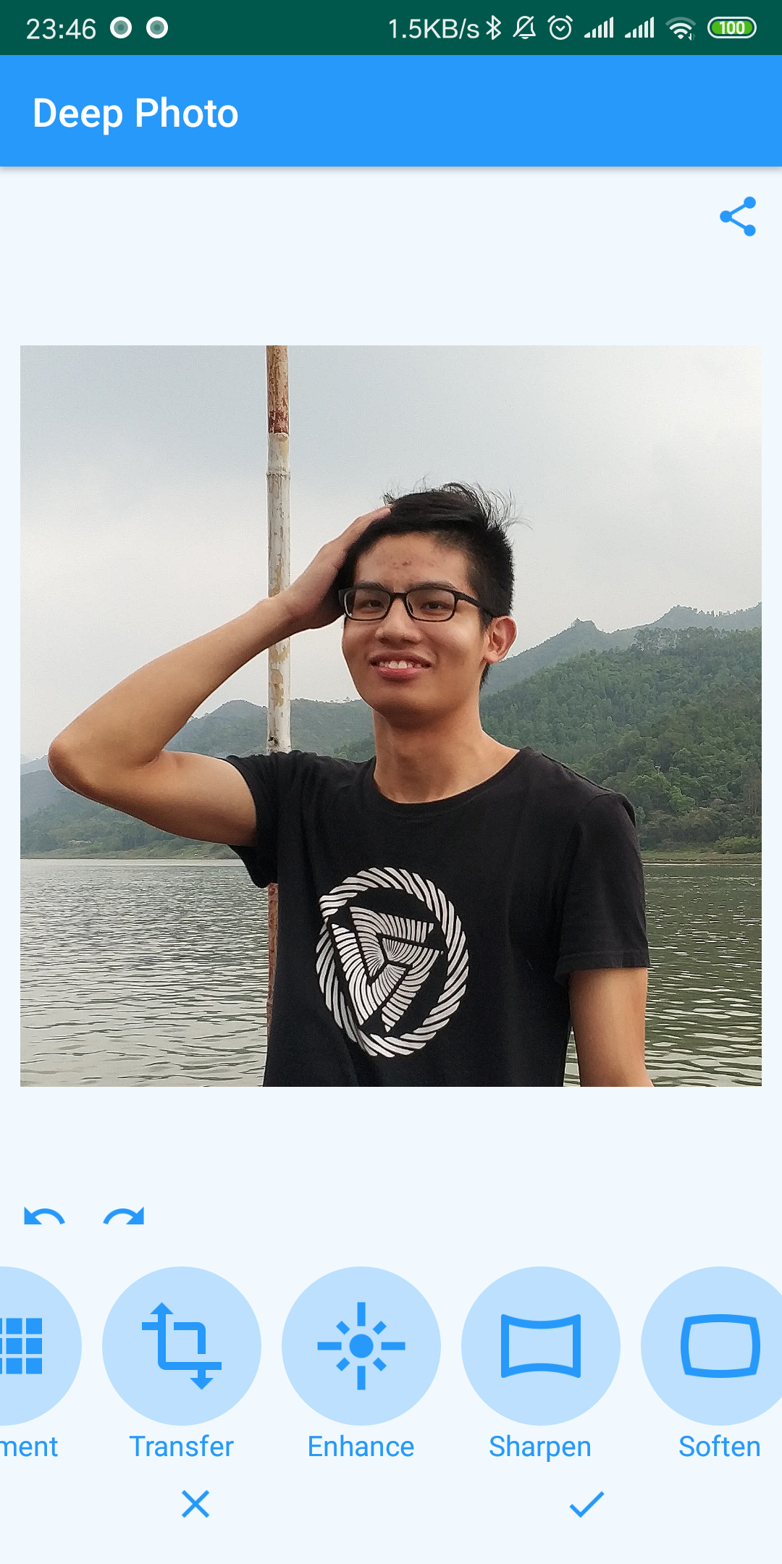
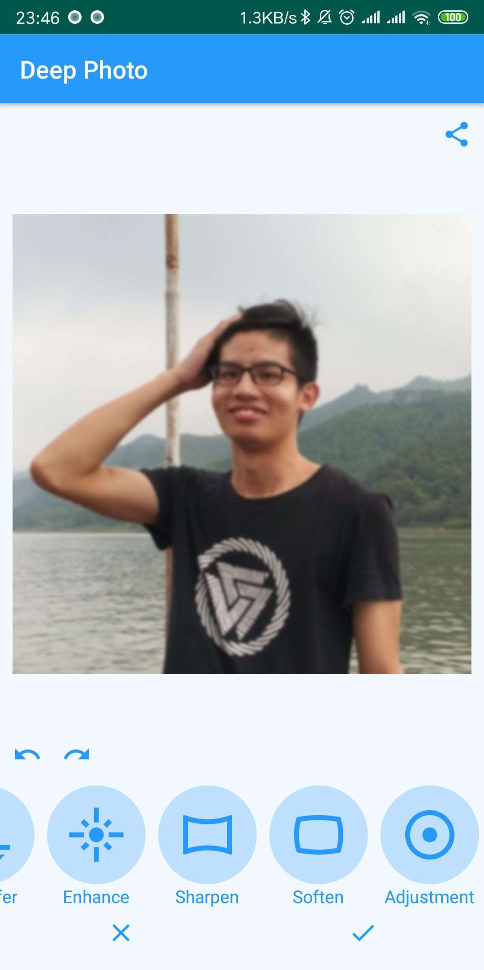
Soften and Sharpen

Slide 17
Outline
Introduction & Scenarios
Timeline
Features
Testing
Conclusions & Future Work

Slide 18
Testing techniques
Using a testing framework for Unit Testing
- Junit
Total number of tests: 27

Slide 19
Testing techniques
Usability testing
Software performance testing
Output comparison testing
Smoke testing

Slide 20
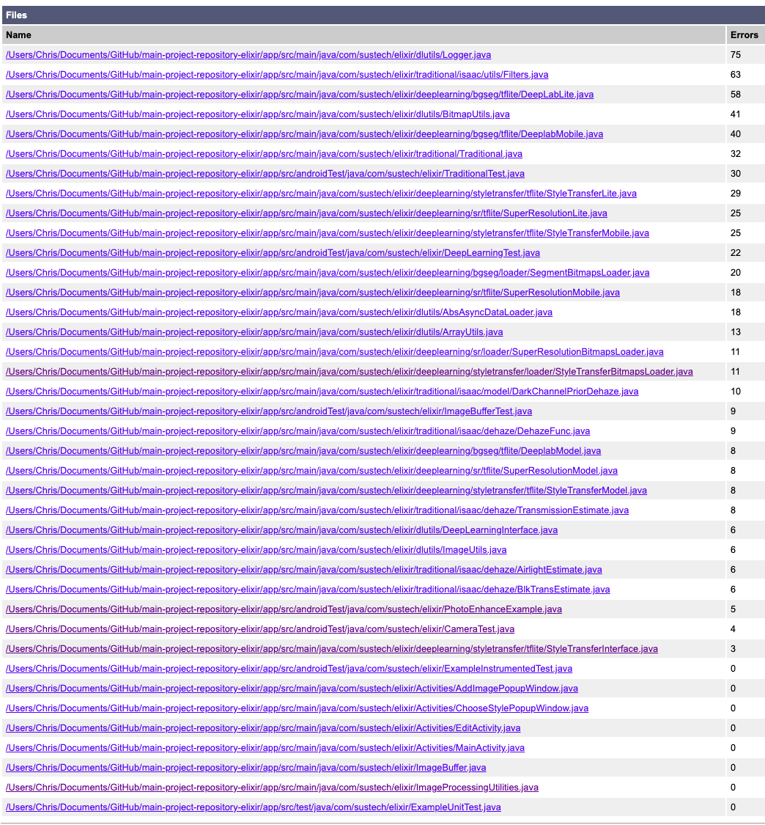
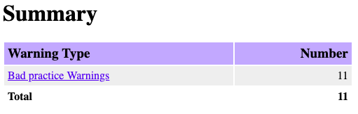
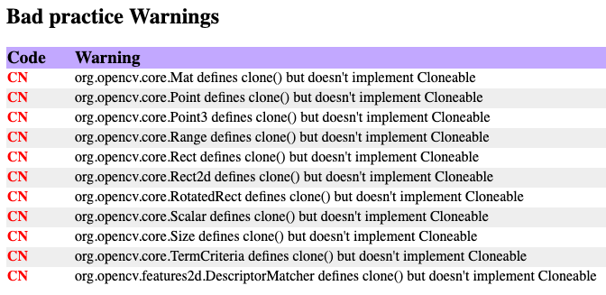
Static analysis
CheckStyle
FindBugs
These are from the openCV library!

Slide 21
Outline
Introduction & Scenarios
Timeline
Features
Testing
Conclusions & Future Work

Slide 22
Main ideas & Results
Advanced Image Processing Tools using Deep Learning.
Light & User Friendly.
All requirements have been satisfied.

Slide 23
Conclusions
Testing is important.
Cost to fix a defect is growing with time.
Balancing on performance & efficiency is hard.
Tensorflow-lite does not support a lot of advanced but common operations.

Slide 24

Q&A

